Slide 1
Service Fabric Actors
Ryan McIntyre
Cloud Solution Architect, Microsoft
@ryanmcintyre

Slide 2
Agenda
Intro to Service Fabric
Virtual Actor Pattern
Good and Bad Usage Patterns
Conclusion

Slide 3
Service Fabric

Slide 4
In the wild… go create a PaaS yourself!
Rolling Upgrades
Availability Guarantees
Scale Out Architecture
Resource Governance
Density
Packaging & Deployment
Policy Enforcement
Granular Versioning
Stateful Workloads
Leader Election
Mesos
Kubernetes
Zookeeper
Redis
Raven
MongoDB
Yarn
Fleet
Hadoop
Containers
?

Slide 5

An easier, battle-tested approach
Service Fabric
Rolling Upgrades
Availability Guarantees
Scale Out Architecture
Resource Governance
Density
Packaging & Deployment
Policy Enforcement
Granular Versioning
Stateful Workloads
Leader Election

Slide 6



Azure Service Fabric
Web Apps
ASP.NET Core
- OWIN
Reliable Actors
Guest Executables
(Any Code)
Reliable Services
Containers
(Windows Containers & Docker)
Lifecycle
Management
Always On Availability
Programming Models
Health & Monitoring
Dev & Ops Tooling
Auto
scaling
Orchestration
Dev Box
Azure
On Premises
Data centers
Other Clouds

Slide 7

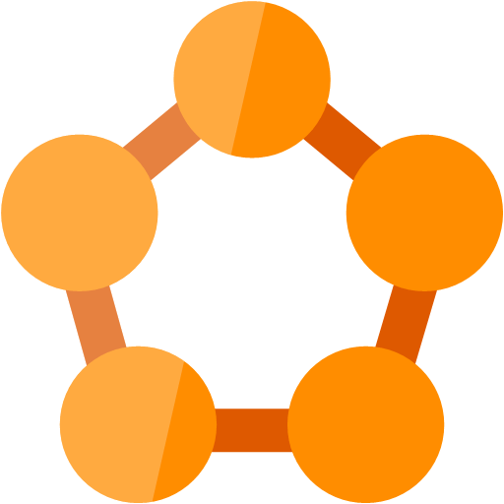

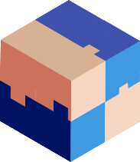



Migrating a traditional application to microservices
Traditional app
Hosted as guest executable or container in Service Fabric
With new microservices added alongisde
Breaking into microservices
Transformed into microservices
…You can stop at any stage

Slide 8
Service Fabric – Some Numbers
Scale: Thousands of Nodes
Density: Tens of Thousands of Workloads per Node
Reliability: Detect and Respond to Failure in Seconds
Manageability: Deploy and Upgrade in Minutes, automatically roll back on errors
Orchestration capabilities become critical when you want scale and reliability:
There is simply too much moving for people to address every contingency.

Slide 9




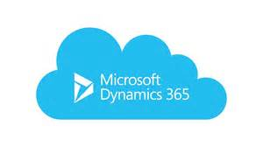

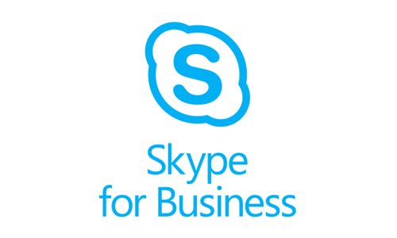

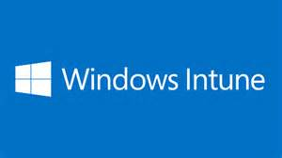
Powered by Service Fabric…
Document DB
Billions transactions/day
IoT Hub
10 of Ks devices &
millions of messages
Event Hubs
640bn events/day
SQL Database
2.0 million DBs
Skype
Cortana
Intune
Dynamics
Power BI

Slide 10
Reliable Actors

Slide 11
Overview
Virtual Actor pattern
Actors are never explicitly created but can be explicitly deleted
Synchronous RPC communication
Single-threaded execution
Local state storage
Notes:
Doesn’t work the same as other actor frameworks.

Slide 12
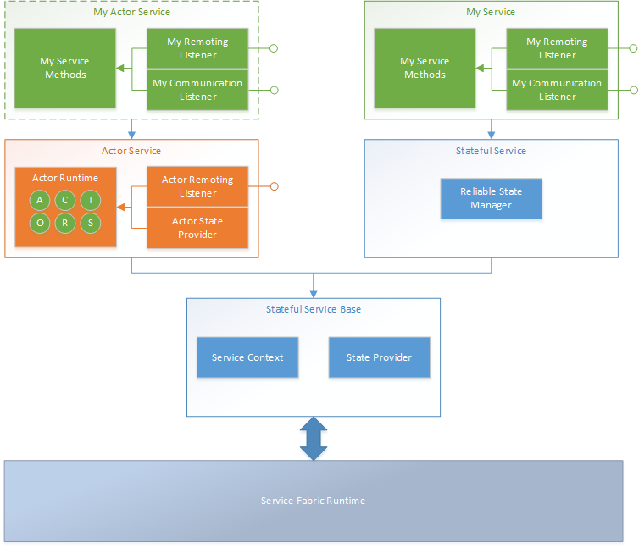
Reliable Actors service layering
Notes:
Built on top of Reliable Services. This is just one possible framework.

Slide 13
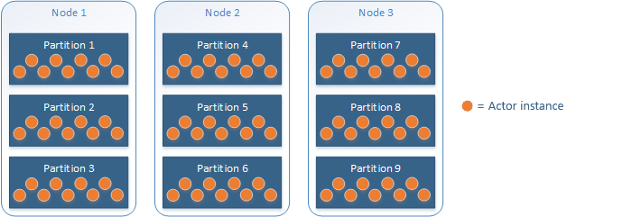
Partitioning and distribution
Actor instances are randomly distributed across service partition.
Notes:
In advanced cases, use int-64 IDs to control partition placement.

Slide 14
Actor types and instances
Many actor instances are created from an actor type and hosted in an actor service
Actor type
Actor instances

Slide 15
Turn-based access and transactions
Every actor method call is wrapped in a transaction scope and a lock on the actor class.
Task IActor1.SetCountAsync(int count, CancellationToken cancellationToken)
{
return this.StateManager.AddOrUpdateStateAsync("count", count,
(key, value) => count > value ? count : value, cancellationToken);
}
Lock on actor class
Transaction scope
While this method is executing, no other actor method may execute.
Notes:
To be precise actor state changes are transactional. This exclude reminders. Each reminder method is transactional in it self.

Slide 16
Synchronous RPC
A call to an actor through ActorProxy does not complete until the remote method completes, represented by a Task
Call start
Task IActor1.SetCountAsync(int count, CancellationToken cancellationToken)
{
return this.StateManager.AddOrUpdateStateAsync("count", count,
(key, value) => count > value ? count : value, cancellationToken);
}
Call complete
Notes:
ActorProxy is the communication mechanism.

Slide 17
Turn-based access limitations
Single-threaded
Writes block other writes
Writes block other reads
Reads block other writes
Reads block other reads

Slide 18
Turn-based access limitations
During actor method execution, all incoming calls are blocked.
Long-running I/O operations can block progress

Slide 19
Turn-based access limitations
Using a continuation on a long-running I/O operation to unblock other actor methods
async Task<int> IActor1.LongRunningOperationAsync(CancellationToken cancellationToken)
{
externalDependency.CallAsync.ContinueWith(async t =>
{
await this.StateManager.SetStateAsync<string>("key", "value");
});
}
Continuation will run outside of state transaction and method lock
Cannot perform state operations here

Slide 20
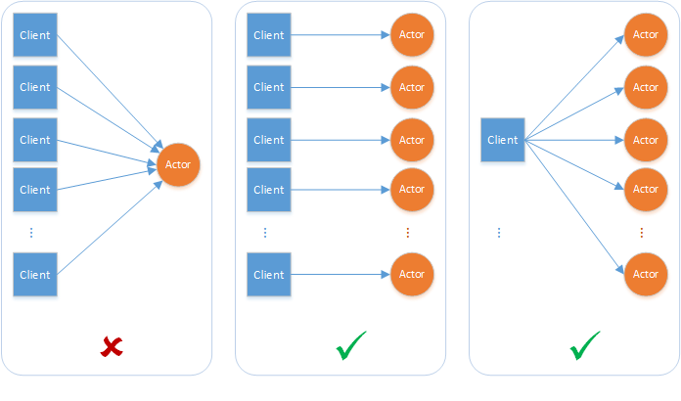
Turn-based access limitations
A single actor instance cannot handle concurrent requests
Notes:
Concurrency model is based on lots of actor instance, each doing ONE thing.

Slide 21
Architectural anti-pattern
Architectures where a single actor instance needs to process concurrent requests won’t scale.

Slide 22
Architectural anti-pattern
Architectures where users make requests directly to an actor
Notes:
Like a UI thread, users’ experience should never be blocked on other actor methods.

Slide 23
State storage
Persistent, volatile, or none
Active actor state is kept in memory
StateManager provides a small dictionary for actor state
Keep state granular
Don’t let state grow indefinitely for a single key

Slide 24
State access
Every actor instance encapsulates its state
To access an actor’s state, you must go through an actor method
Task<int> IActor1.GetCountAsync(CancellationToken cancellationToken)
{
return this.StateManager.GetStateAsync<int>("count", cancellationToken);
}

Slide 25
State access limitations
Enumerating or querying state across actors is very expensive.
Each iteration is an I/O operation, and may have to wait for other actor methods to finish executing.
Notes:
And since calls to an actor are not ordered, total time to make such query may vary time to time.

Slide 26
Architectural anti-pattern
Architectures where actor instances are used as a general state store won’t scale.

Slide 27
Actor pattern scenarios
Your problem space involves a large number (thousands or more) of small, independent, and isolated units of state and logic.
You want to work with single-threaded objects that do not require significant interaction from external components, including querying state across a set of actors.
Your actor instances won't block callers with unpredictable delays by issuing I/O operations.

Slide 28
Pattern: notification actor service
Service creates actor instances to periodically fetch, process, and filter data, and notify service with filtered events.
Works best with many individual notification actors.

Slide 29
Pattern: distributed processing
Service creates actor instances to individually process data
Notes:
Parallel processing – create actor instances to compute small pieces of a larger workload.
Pull data from blog storage to process.
Use a reminder to initiate work so that service does not need to wait for work to complete.

Slide 30
In Review
How Reliable Actors fit in Service Fabric
Understand which scenarios should use Reliable Actors
Design scalable Reliable Actor solutions for appropriate scenarios
The actor pattern is a highly specialized design pattern

Slide 31
Session resources
Guidance available in Reliable Actors Overview:
https://docs.microsoft.com/en-us/azure/service-fabric/service-fabric-reliable-actors-introduction
Report issues on GitHub
https://github.com/Azure/service-fabric-services-and-actors-dotnet

Slide 32

© 2017 Microsoft Corporation. All rights reserved. Microsoft, Windows, Windows Vista and other product names are or may be registered trademarks and/or trademarks in the U.S. and/or other countries.
The information herein is for informational purposes only and represents the current view of Microsoft Corporation as of the date of this presentation. Because Microsoft must respond to changing market conditions, it should not be interpreted to be a commitment on the part of Microsoft, and Microsoft cannot guarantee the accuracy of any information provided after the date of this presentation. MICROSOFT MAKES NO WARRANTIES, EXPRESS, IMPLIED OR STATUTORY, AS TO THE INFORMATION IN THIS PRESENTATION.

